Slide 1
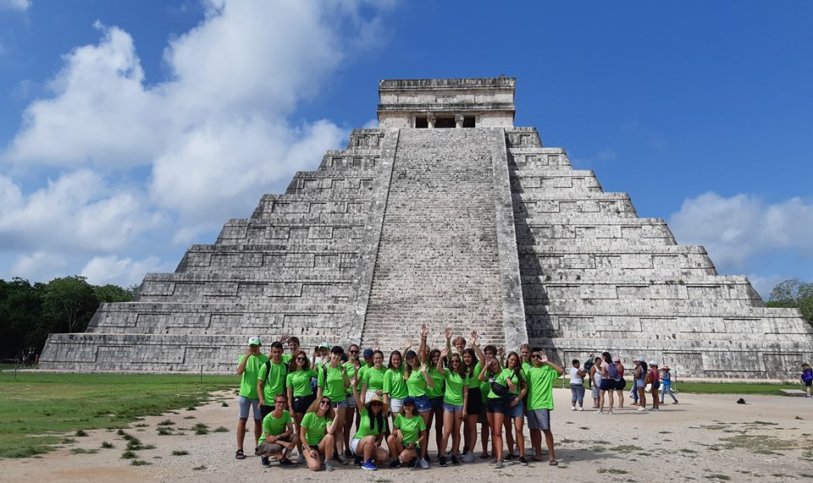
4th International Summer CAMP 4th to 21st of July ´2019.
The
Riviera Maya
Discover

Slide 2
Important Information
Participants: (Only 18): 1 boy and 1 girl per Country.
Age: 15–19 years old.
No Vegans, Vegetarians and Celiacs.
Language: Participants must have a good level of English.
Duration: 18 days.
Accommodation: Host Families.
Clothing: Casual and Formal. You need sport clothes and walking shoes. Bring sunscreen and beach clothes! Please bring a Formal clothe for a night Rotary party and other for the Rotary Meeting.
Special Requirement: Bring 1 Rotary banner from your sponsor Rotary Club.
Cost: Participants will have to pay a registration fee of $950 Euro. Please make a payment of 450 euros before their arrival to secure their place in the camp, they have until March 20 to make this payment otherwise their place will be given to another interested participant. The rest 500 euros of the payment will be payed in cash and deliver it on arrival at the camp to the camp coordinator.

Slide 3
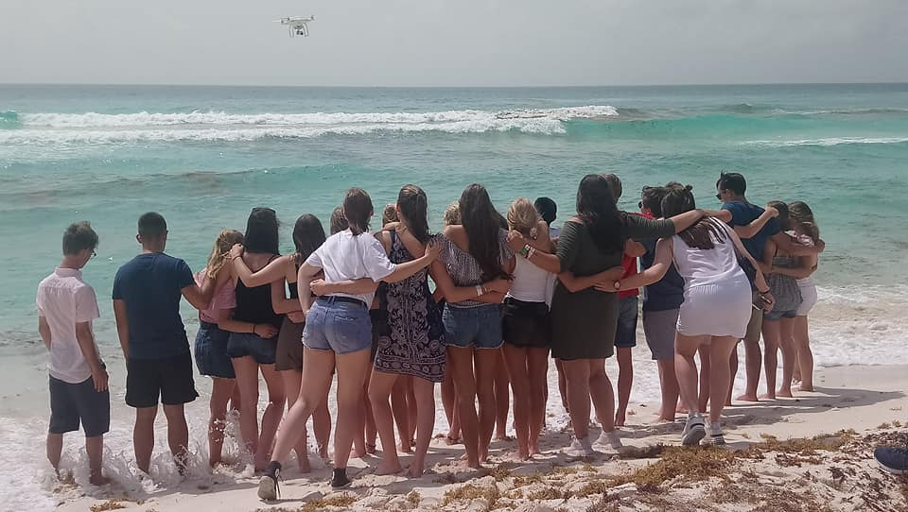
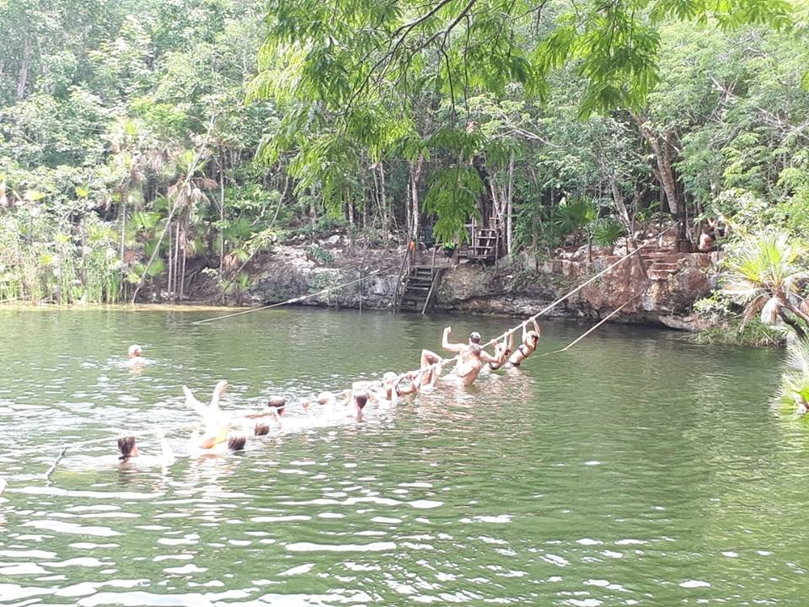
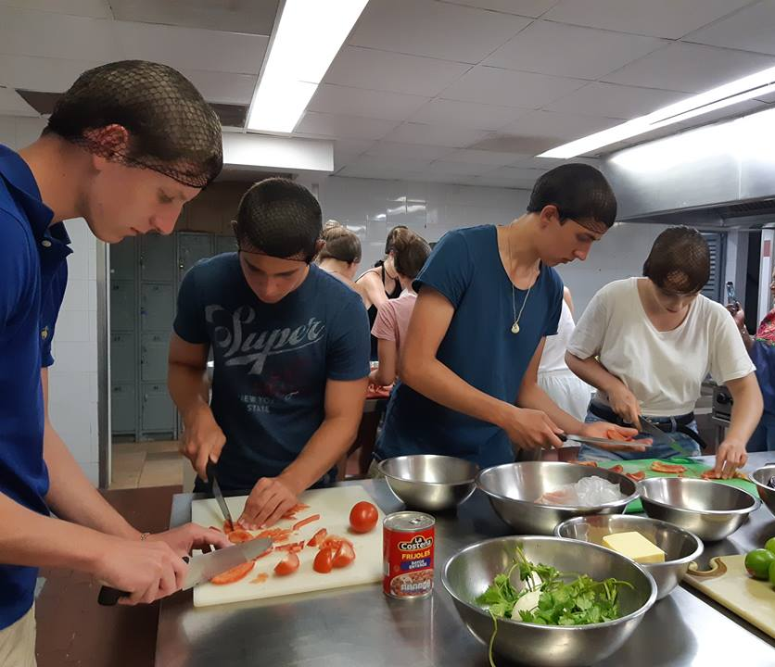
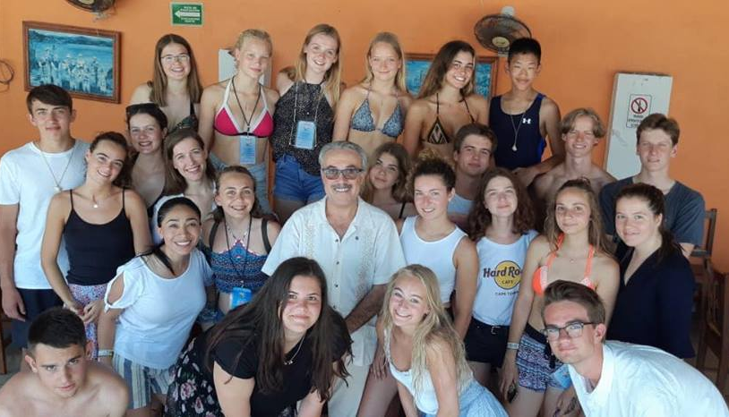
Insurance: All participants must be insured against illness, accident and third party damage according to Rotary International recommendations. Participants must make the payment of 40 Euro in the Camp upon arrival.
Alcohol & Smoking: May not be consumed under 18 years old. Host families will permit moderate consumption to those participants over 18 years old.
Arrival/Departure: International Cancun Airport (CUN). Participants from the same country must travel together. They can not arrive before or after the dates indicated.
Application: Send it to juanirabelo@hotmail.com until March 15th, 2018.

Slide 4
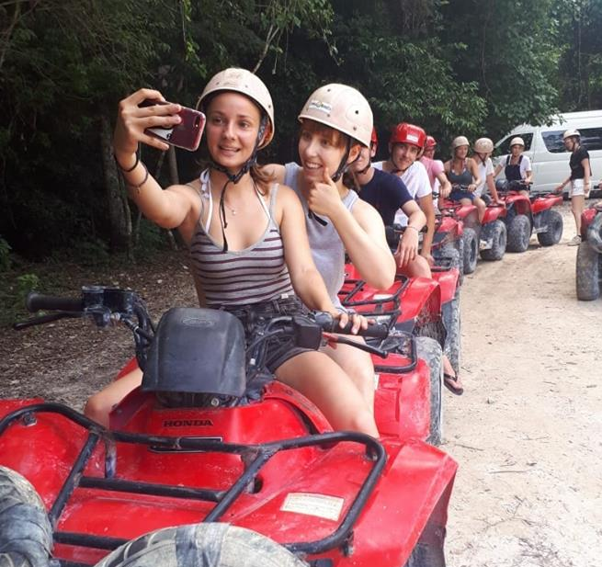
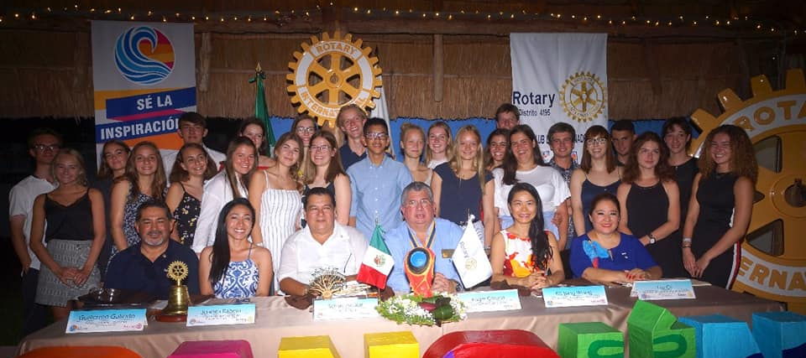
The Riviera Maya is an ideal vacation destination, is home to some of the most stunningly beautiful beaches in all of Mexico with expansive stretches of powdery white sand lapped by the clear turquoise waters of the Caribbean Sea.
The Riviera Maya is a top ecotourism destination in Mexico and throughout the region the natural environment is protected and preserved. Outside of the major tourist destinations, much of the land remains relatively undeveloped so the natural beauty of the Riviera Maya and the creatures that inhabit it are left to flourish.

Slide 5
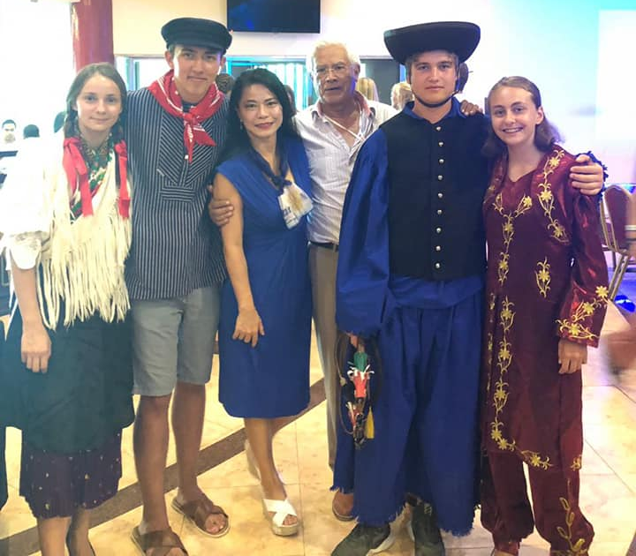
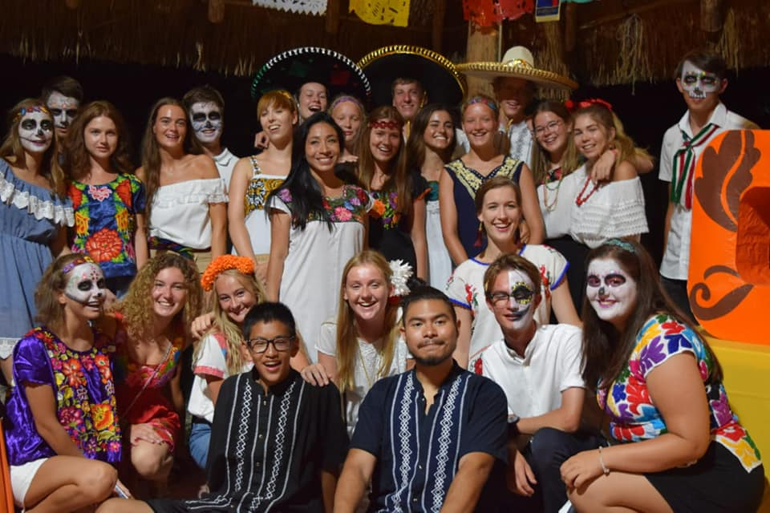
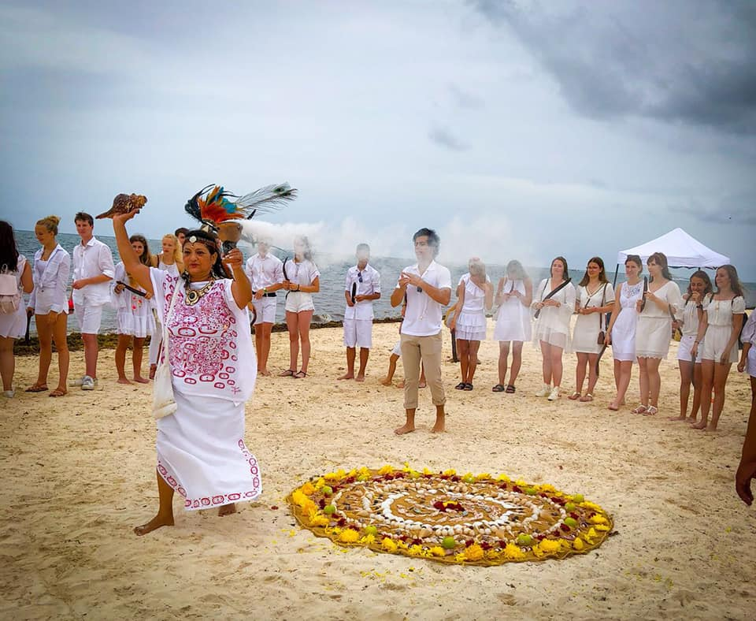
Mexico is a country rich in history, culture and tradition, all of which you will experience when you visit the Riviera Maya.
WE WILL HAVE A LOT OF FUN!!!......
Juanita Rabelo
STEP,NGSE & CAMP CHAIR
D.4195 – MEXICO
Don’t hesitate in contact me if you need more information….
juanirabelo@hotmail.com

